Slide 1
Business Intelligence G. Mudare
Notes:
Introduce yourself to the students and also find out there names
Have them give you in 30 seconds a summary of who they are and what there interest in IT is

Slide 2
Data Mining
Functionalities

Slide 3
Data Mining Functionalities
Data mining functionalities are used to specify the kind of patterns to be found in data mining tasks.
In general, data mining tasks can be classified into two categories:
Descriptive mining tasks characterize the general properties of the data in the database.
Predictive mining tasks perform inference on the current data in order to make predictions.

Slide 4
Data mining functionalities
Concept/Class Description: Characterization and Discrimination
Mining Frequent Patterns, Associations, and Correlations
Classification and Prediction
Cluster Analysis
Outlier Analysis
Evolution Analysis

Slide 5
Concept/Class Description Characterization and Discrimination
Data can be associated with classes or concepts.
E.g., classes of items for sale include computers and printers, and concepts of customers include big Spenders and budget Spenders.
Useful to describe individual classes and concepts in summarized, concise, and yet precise terms.
Such descriptions of a class or a concept are called class/concept descriptions.
These descriptions can be derived via
(1) Data characterization, by summarizing the data of the class under study (often called the target class)
(2) Data discrimination, by comparison of the target class with one or a set of comparative classes (often called the contrasting classes),
(3) both data characterization and discrimination.

Slide 6
Data characterization
Data characterization is a summarization of the general characteristics or features of a target class of data. collected by a database query.
Eg. to study the characteristics of software products whose sales increased by 10% in the last year,
Produce a description summarizing the characteristics of customers who spend more than $1,000 a year at the electronics store. (Eg general profile of the customers, such as they are 40–50 years old, employed, and have excellent credit ratings.)
System should allow users to drill down on any dimension, such as on occupation in order to view these customers according to their type of employment.

Slide 7
Data discrimination
Comparison of the general features of target class data objects with the general features of objects from one or a set of contrasting classes.
Eg. compare the general features of software products whose sales increased by 10% in the last year with those whose sales decreased by at least 30% during the same period.
A data mining system should be able to compare two groups of Electronics customers, such as those who shop for computer products regularly versus those who rarely shop for such products
Result could be a comparative profile of the customers such as,
80% of the customers who frequently purchase computer products are between 20 and 40 years old and have a university education, whereas 60% of the customers who infrequently buy such products are either seniors or youths, and have no university degree.
Drilling down on a dimension, such as occupation, or adding new dimensions, such as income level, may help in finding even more discriminative features between the two classes

Slide 8
Mining Frequent Patterns, Associations, and Correlations
Frequent patterns, as the name suggests, are patterns that occur frequently in data.
Kinds of frequent patterns:
Itemsets→items that frequently appear together in a transactional data set, such as milk and bread
subsequences → subsequence, such as the pattern that customers tend to purchase first a PC, followed by a digital camera, and then a memory card, is a (frequent) sequential pattern.
Substructures. Refer to different structural forms, such as graphs, trees, or lattices, which may be combined with itemsets or subsequences.

Slide 9
Example
Association analysis. Suppose, as a marketing manager of the Electronics shop, would like to determine which items are frequently purchased together within the same transactions.
An example of such a rule, mined from the Electronics transactional database, is
Buys(x; “computer”)→ buys(x; “software”) [support = 1%; confidence = 50%]
“computer → software [1%, 50%]”.
X is a variable representing a customer.
A confidence, or certainty, of 50% means that if a customer buys a computer, there is a 50% chance that she will buy software as well.
A 1% support means that 1% of all of the transactions under analysis showed that computer and software were purchased together

Slide 10
Another Example
Suppose, instead, that we are given the Electronics shop relational database relating to purchases.
A data mining system may find association rules like
age(X, “20:::29”) ^ income(X, 20K:::29K”)→buys(X, “CD player”) [support = 2%, confidence = 60%]
The rule indicates that of the Electronics customers under study, 2% are 20 to 29 years of age with an income of 20,000 to 29,000 and have purchased a CD player There is a 60% probability that a customer in this age and income group will purchase a CD player.
Association rules are discarded as uninteresting if they do not satisfy both a minimum support threshold and a minimum confidence threshold.
Additional analysis can be performed to uncover interesting statistical correlations between associated attribute-value pairs.

Slide 11
Classification and Prediction
Classification is the process of finding a model (or function) that describes and distinguishes data classes or concepts, for the purpose of being able to use the model to predict the class of objects whose class label is unknown.
Derived model is based on the analysis of a set of training data (i.e., data objects whose class label is known). “
Derived model may be represented by
(IF-THEN) rules,
decision trees,
mathematical formulae,
neural networks
Others methods include:
Naïve bayesian classification, support vector machines, and k-nearest neighbour classification.

Slide 12
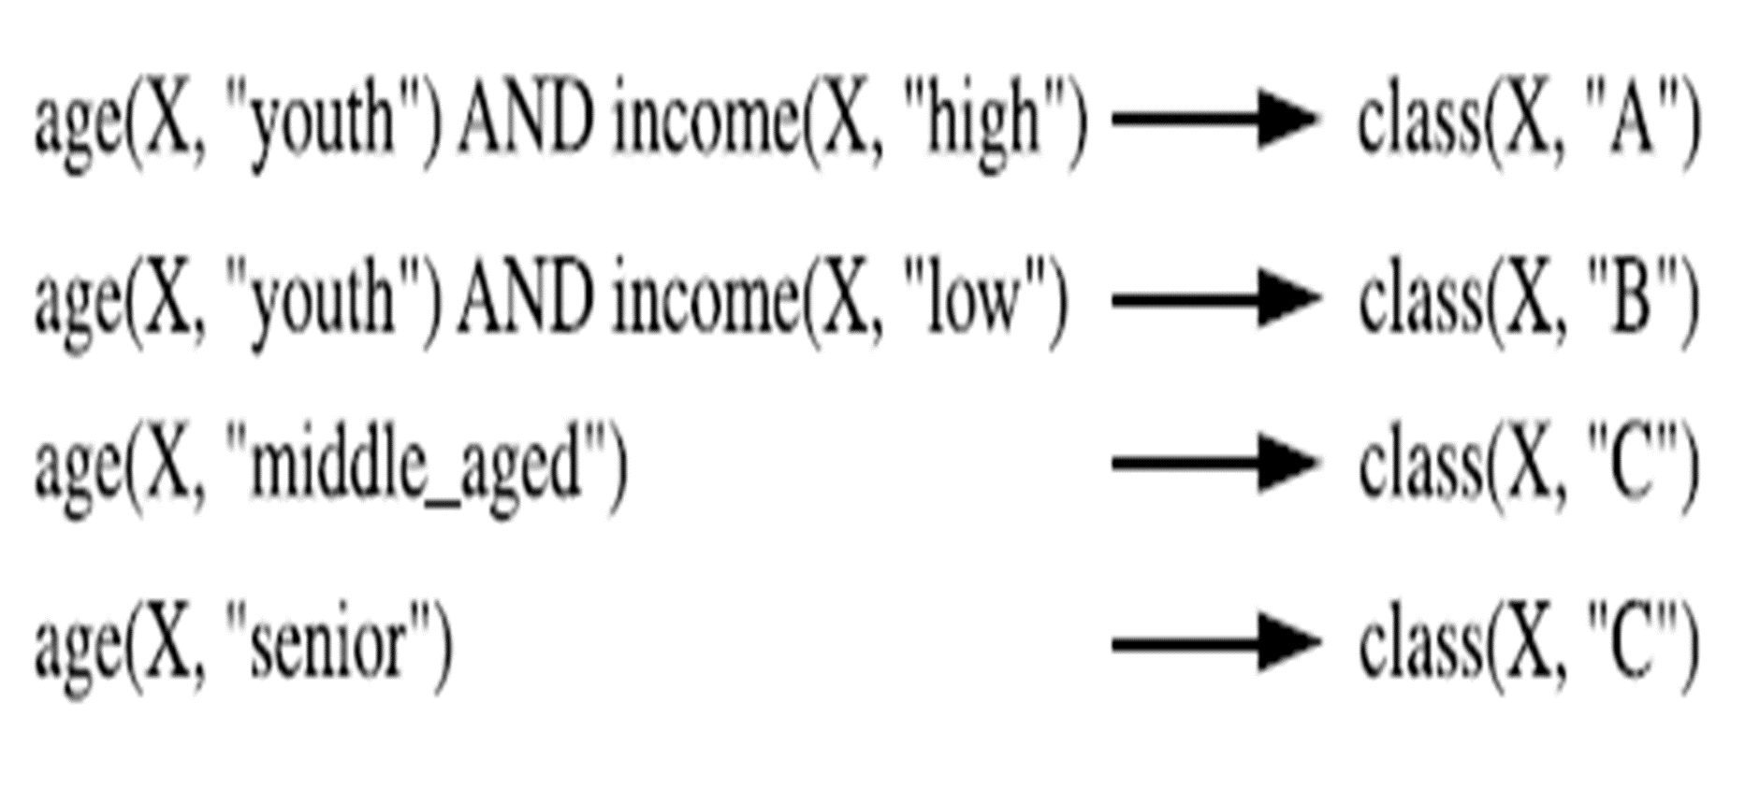
IF-Then

Slide 13
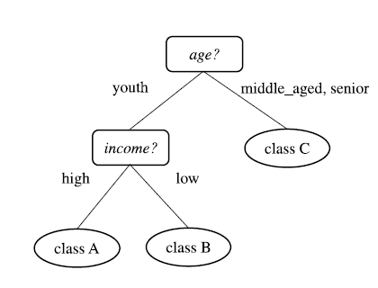
Decision Tree

Slide 14
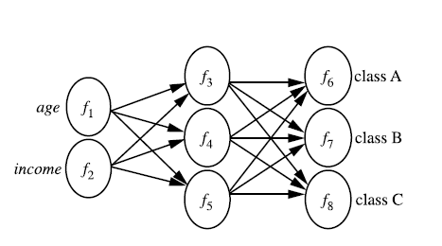
Neural Network

Slide 15
Prediction
Whereas classification predicts categorical (discrete, unordered) labels, prediction models predict continuous-valued functions.
Predicting missing or unavailable numerical data values rather than class labels.
Types of predictions:
Predict some unavailable data values or pending trends,
Predict a class label for some data.
Regression analysis is a statistical methodology that is most often used for numeric prediction, although other methods exist as well,
Classification and prediction may need to be preceded by relevance analysis,
→ attempts to identify attributes that do not contribute to the classification or prediction process.

Slide 16
Example
Suppose, as a sales manager of the Electronics shop , you would like to classify a large set of items in the store, based on three kinds of responses to a sales campaign: good response, mild response, and no response.
You would like to derive a model for each of these three classes based on the descriptive features of the items, such as price, brand, place made, type, and category.
The resulting classification distinguishes each class from the others, presenting an organized picture of the data set.
Resulting classification can be expressed in the form of a decision tree.

Slide 17
Example
The decision tree, may identify price as being the single factor that best distinguishes the three classes and may also reveal that, after price, other features that help further distinguish objects of each class from another include brand and place made.

